Slide 1




智慧運算技術導論 自然語言處理篇 - Embeddings
林英嘉 (Ying-Jia Lin)
長庚大學人工智慧學系
2026/01/26
Slido
# AIMD (Link)

Slide 2


Slide 3


Ying-Jia Lin
長庚大學 人工智慧學系 助理教授 (2025/02 - )
國立清華大學 資訊工程學系 博士後研究員 (2024 - 2025)
國立成功大學 資訊工程學系 博士 (2019 - 2024)
國立陽明大學 生物醫學資訊研究所 碩士 (2017 - 2019)
長庚大學 生物醫學系 學士 (2013 - 2017)

Slide 4
Outline
深度學習與自然語言處理的概念
Embeddings
Sentence embeddings
Word embeddings

Slide 5
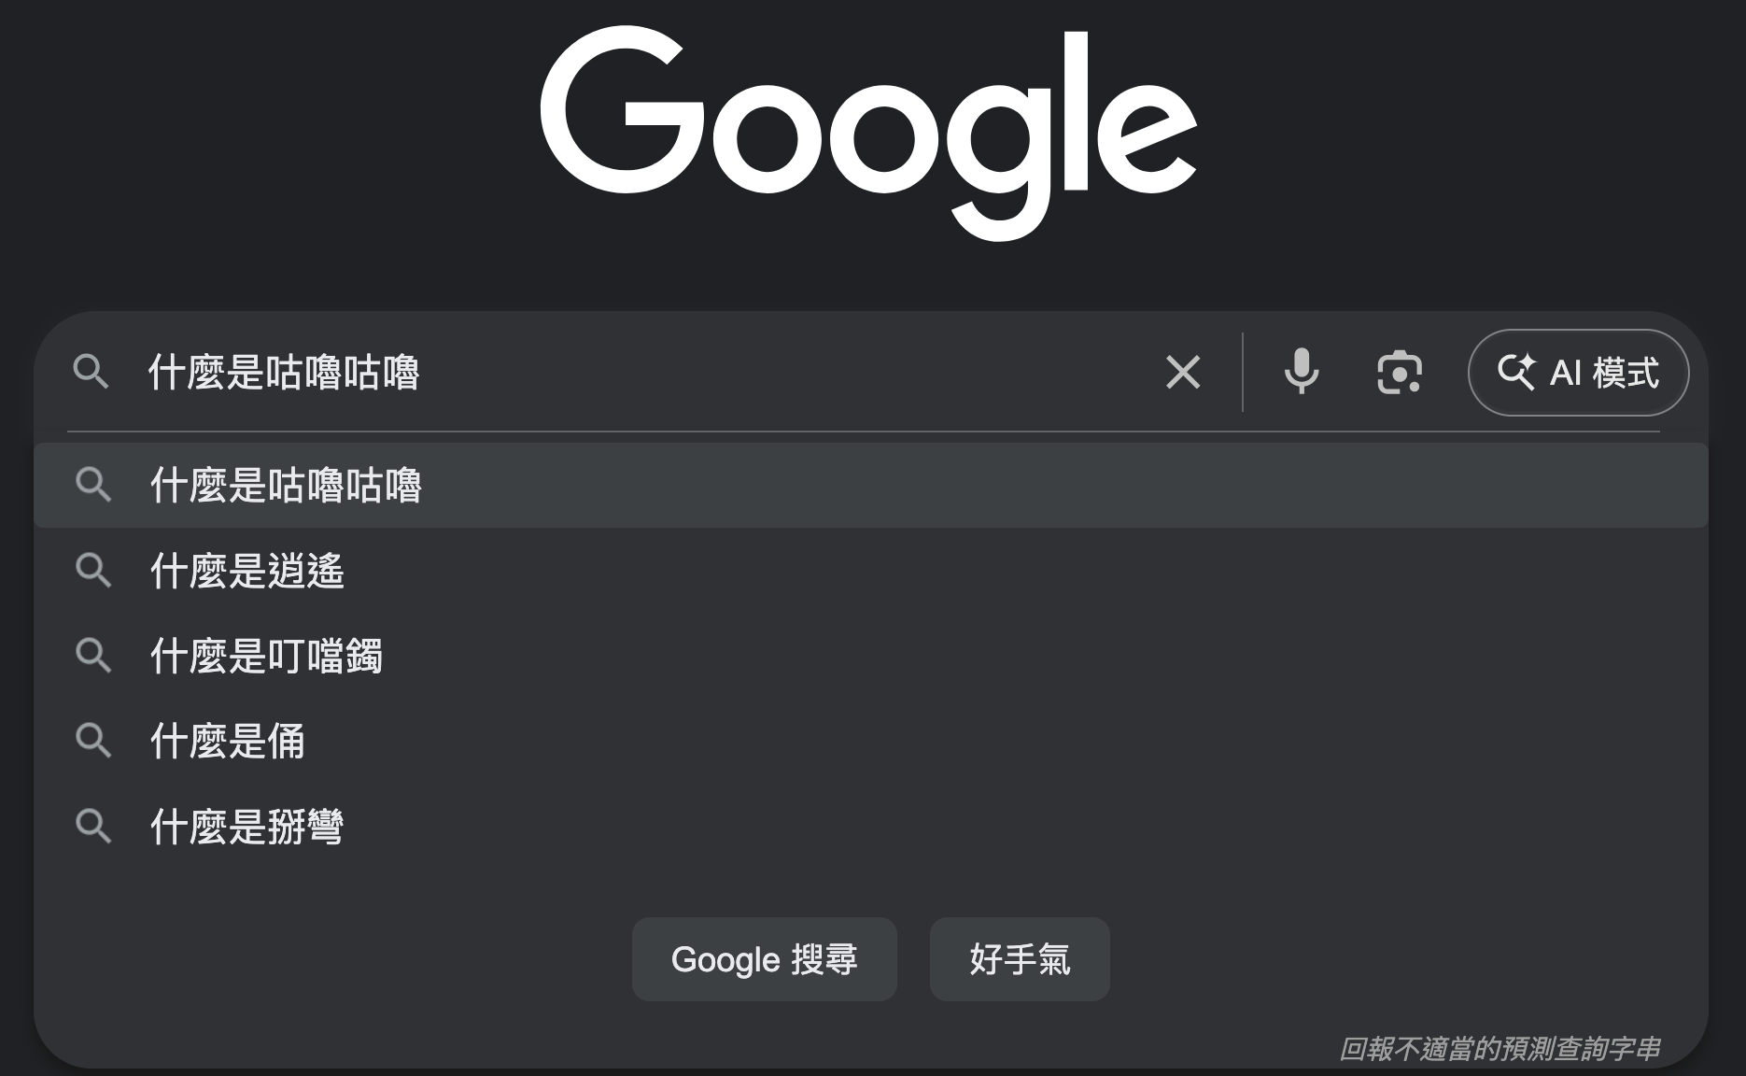
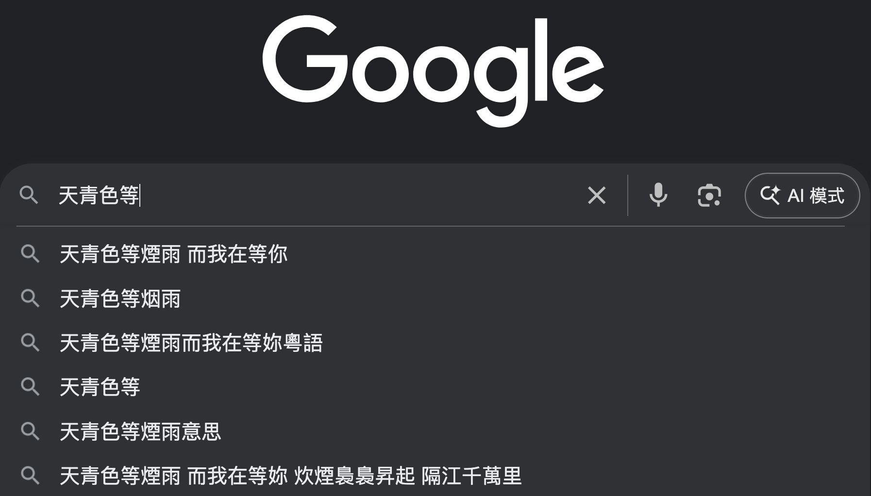
什麼是自然語言處理（Natural Language Processing, NLP）？
文字搜尋
下一個字預測

Slide 6
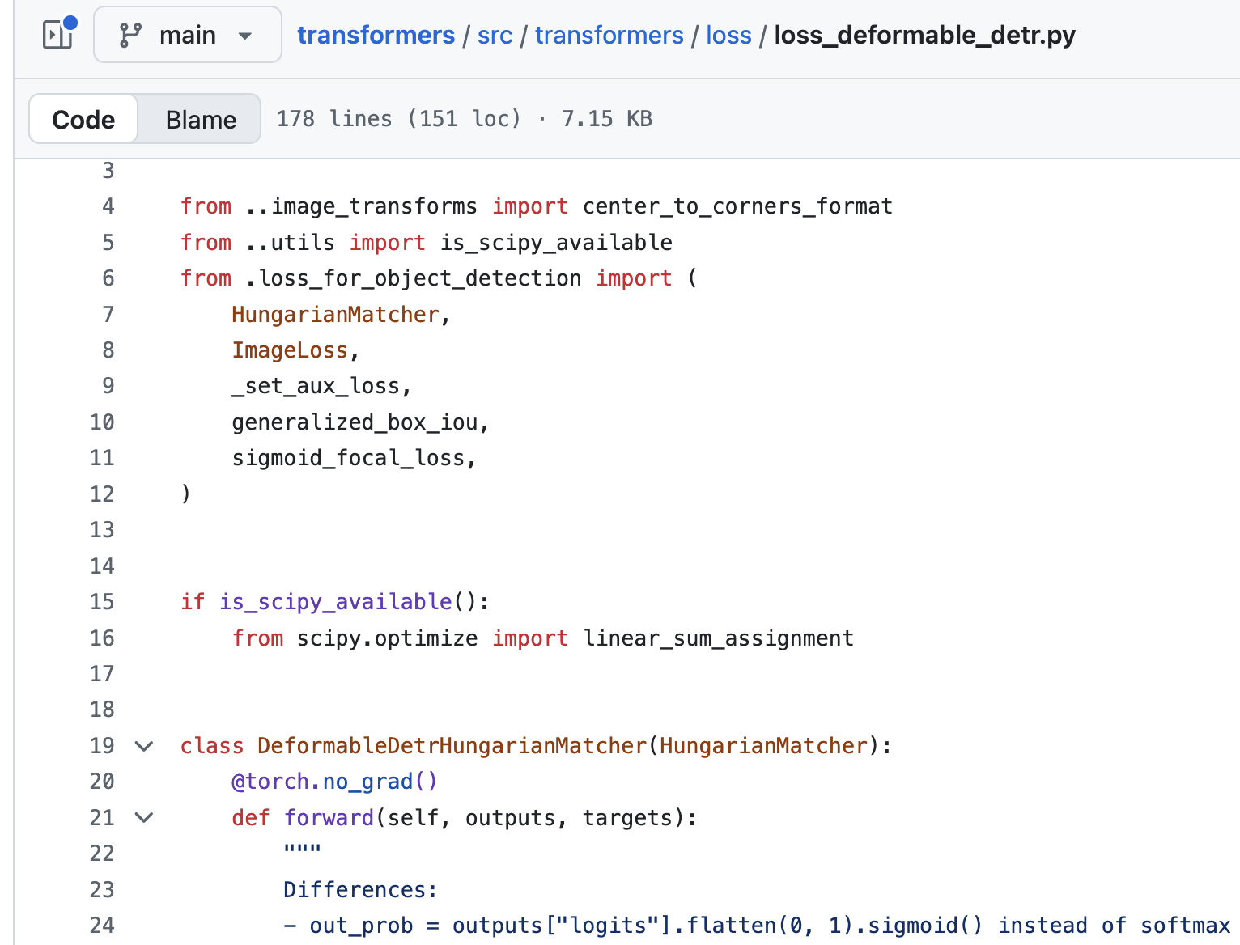
程式語言 vs. 自然語言
程式語言
自然語言
先生不知何許人也，亦不詳其姓字。宅邊有五柳樹，因以為號焉
閑靜少言，不慕榮利。好讀書，不求甚解，每有會意，便欣然忘食。性嗜酒，家貧，不能常得。親舊知其如此，或置酒而招之。造飲輒盡，期在必醉，既醉而退，曾不吝情去留。環堵蕭然，不蔽風日；短褐穿結，簞瓢屢空。——晏如也。常著文章自娛，頗示己志。忘懷得失，以此自終。
贊曰：黔婁之妻有言：「不戚戚於貧賤，不汲汲於富貴。」極其言，茲若人儔乎？酣觴賦詩，以樂其志。無懷氏之民歟！葛天氏之民歟！

Slide 7
什麼是自然語言處理？
天青色等煙雨
🖥️
?
I like apple!
自然語言處理（Natural Language Processing, NLP）
是讓電腦能「理解、分析、產生」人類語言的技術。
定義 ➡️

Slide 8

The Revolution of ChatGPT
ChatGPT came out in November, 2022.
Figure source: https://poole.ncsu.edu/thought-leadership/article/lets-chat-about-chatgpt/
https://openai.com/index/chatgpt/

Slide 9
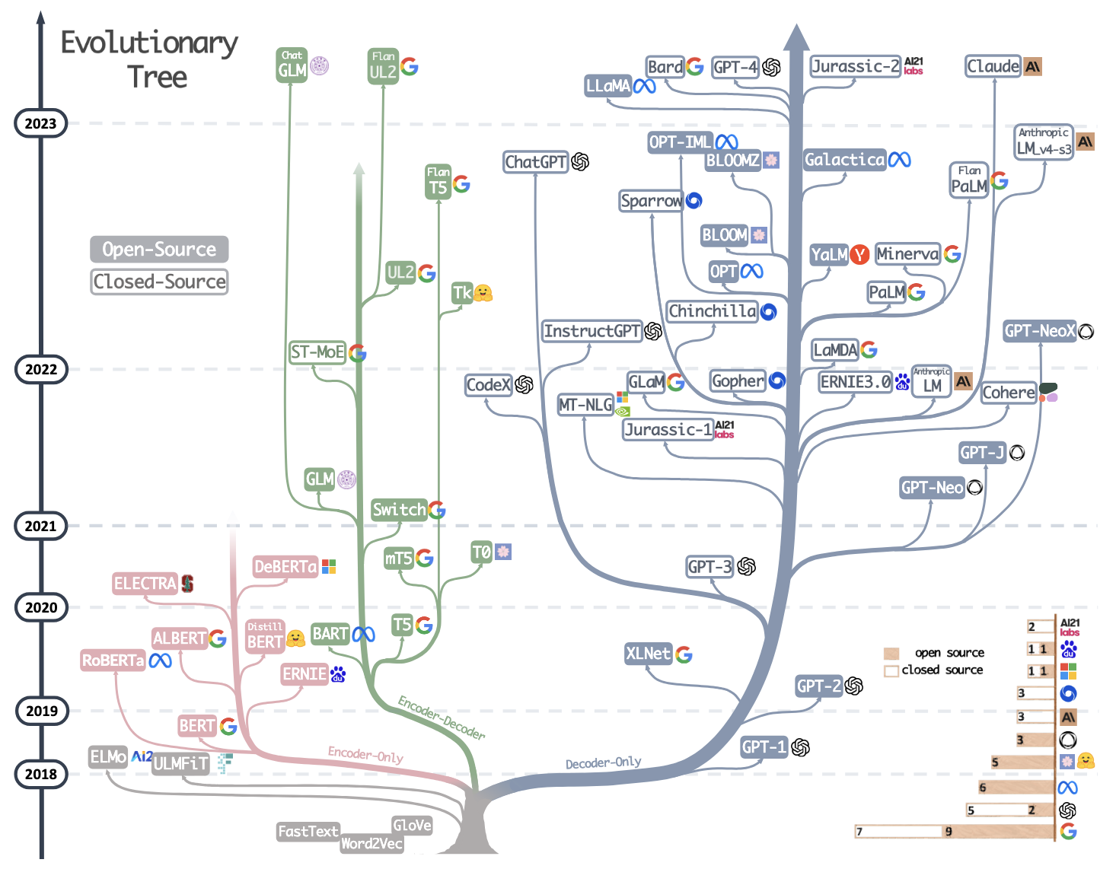
大型語言模型的演化樹
Yang, Jingfeng, et al. "Harnessing the power of llms in practice: A survey on chatgpt and beyond." ACM Transactions on Knowledge Discovery from Data 18.6 (2024): 1-32.

Slide 10
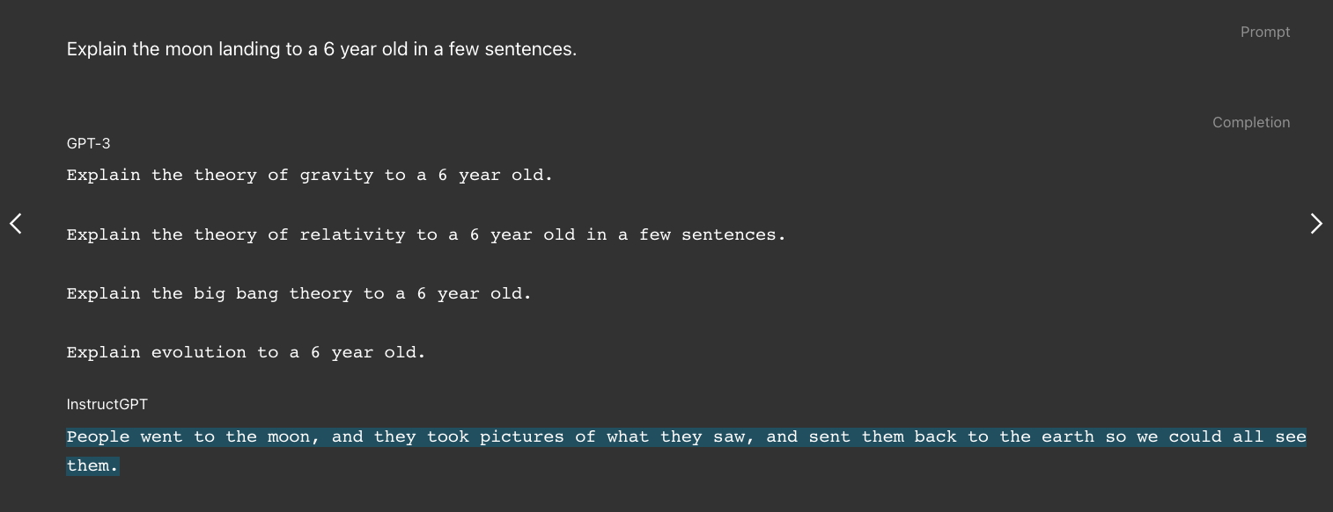
以前的 GPT 有口吃
InstructGPT: ChatGPT 的前身
Figure source: https://openai.com/index/instruction-following/
Ouyang, Long, et al. “Training language models to follow instructions with human feedback.” NeurIPS 2022.

Slide 11
自然語言處理在醫學上的應用？

Slide 12
應用1: 醫療文本分類 (使用 ICD-10 編碼)
Input: radiology report
ICD-10 類別
A 75 Y/O male; Clinical Information:LC-C, Increasing AFP, 2.9> 6.4 > 17.0, RFA on 105-8-2, Please evaluate any recurrenceCT scan of liver for F/U a patient of HCC post RFA was done by using triphasic study without and with bolus IV non-ionic contrast enhancement showed: ** Comparison CT study: 2016-06-24; 2017-3-23 ** 1. Mildly undulated surface of liver with hypertrophy of lateral segment. No ascites. Mild splenogemaly with EVs. Cirrhosis of liver with portal hypertension is considered. 2. Hypodense lesion about 4.4x3.5-cm with lobulated margin in S7, C/W post RFA change. High suspicion of newly developed enhancing viable tumor at posterior aspect with arterial wash-in (se 7, im 15-16). 3. No new liver tumor is found. A small cyst in S4.4. The portal and hepatic venous system are patent. No biliary tree dilatation. 5. No remarkable finding in the gallbladder, pancreas and both kidneys, adrenal glands. 6. No evidence of enlarged lymph node is found in the perigastric area, hepatoduondenal ligament, para-aortic area, pelvis and inguina. 7. Grossly, no abnormality is found in the GI tract. Clear mesentery and omentum. No ascites. 8. Normal contour, capacity and wall thickness of urinary bladder. Normal size and contour of seminal vesicle and prostatic gland. 9. Clear retroperitoneum. Normal contour, diameter and enhancement of abdominal aorta. 10. No active lesion is found in the visualized bilateral lower lungs. 11. Grossly, no destructive bony lesion or abnormal bone density. IMP: Cirrhosis of liver with portal hypertension is noted. A HCC in S7 post RFA with high suspicion of small viability at posterior aspect. No new HCC is found.
K7689 Other specified diseases of liver
✓
C220 Liver cell carcinoma
✓
Z4889 Encounter for other specified surgical aftercare
✓
K7460 Cirrhosis
✓
K760 Fatty (change of) liver, not elsewhere classified
C770-C779 Secondary and unspecified malignant neoplasm
D1803 Hemangioma of intra-abdominal structures

Slide 13
ICD-10 國際疾病分類編碼
ICD-10: 《疾病和有關健康問題的國際統計分類》第10次修訂本
The International Statistical Classification of Diseases and Related Health Problems 10th Revision
章節 | 編碼範圍 | 標題
I | A00-B99 | 某些傳染病和寄生蟲病
II | C00-D48 | 腫瘤
III | D50-D89 | 血液及造血器官疾病和某些涉及免疫系統的疾患
... | ... | ...
G43001 無預兆偏頭痛，非頑固性，伴有偏頭痛重積狀態
J00 急性鼻咽炎（感冒）
試試➡️國際疾病分類查詢系統
https://info.nhi.gov.tw/inae5000/INAE5010S01

Slide 14
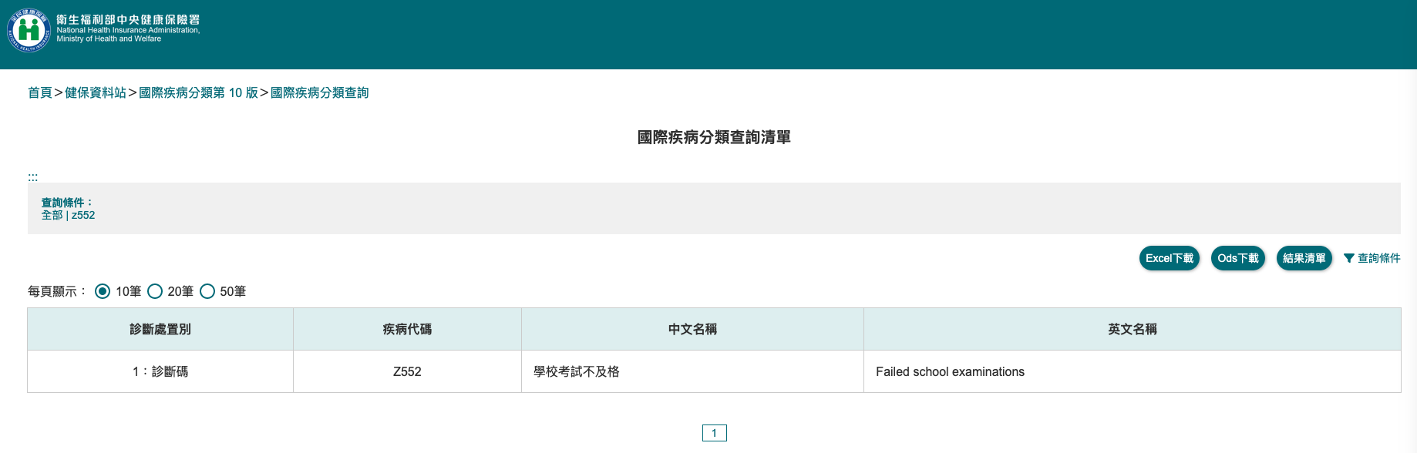
Z開頭是跟健康狀態有關的項目

Slide 15
應用2: 命名實體辨識 (Named Entity Recognition, NER)
B-Person
B-Location
I-Location
I-Location
E-Person
John Wick was admitted to Taipei Veterans General Hospital on March 3, 2023 due to pneumonia.
O
O
O
E-Location
O
B-Time
E-Time
O
O
B-Disease
 | Meaning
B | Beginning
I | Inside
O | Outside
E | End

Slide 16
應用2: 於文中標註出疾病分類位置
J181
J90
A 65-year-old male presented with progressive shortness of breath and productive cough for two weeks. Chest X-ray revealed right lower lobe pneumonia with mild pleural effusion. The patient also had a history of type 2 diabetes mellitus and essential hypertension. Laboratory tests showed elevated white blood cell count and C-reactive protein. He was admitted for intravenous antibiotics and further management.
E119
I10
➡️ 命名實體辨識 (Named Entity Recognition, NER)

Slide 17
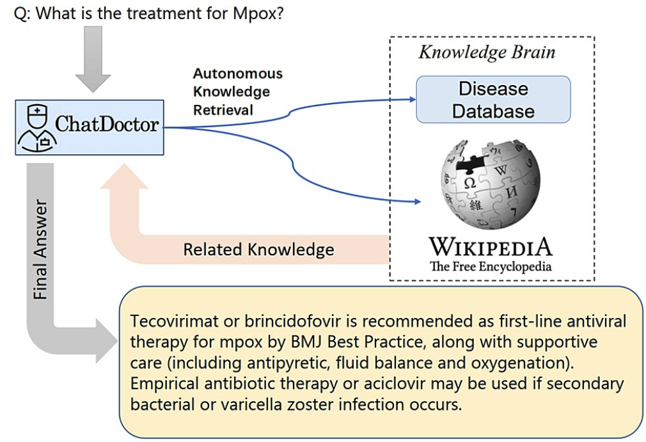
應用3: ChatDoctor (醫學問答系統)
Li, Yunxiang, et al. "Chatdoctor: A medical chat model fine-tuned on a large language model meta-ai (llama) using medical domain knowledge." Cureus 15.6 (2023).
(查詢資料庫)

Slide 18
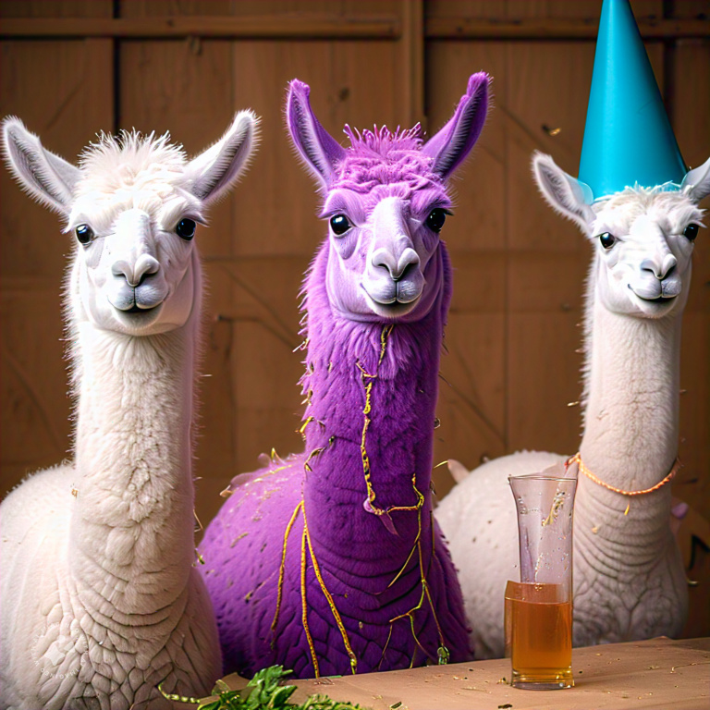

很多厲害的大型語言模型都需要上網...
Llama (7B - 65B) by Meta (2023)

Slide 19
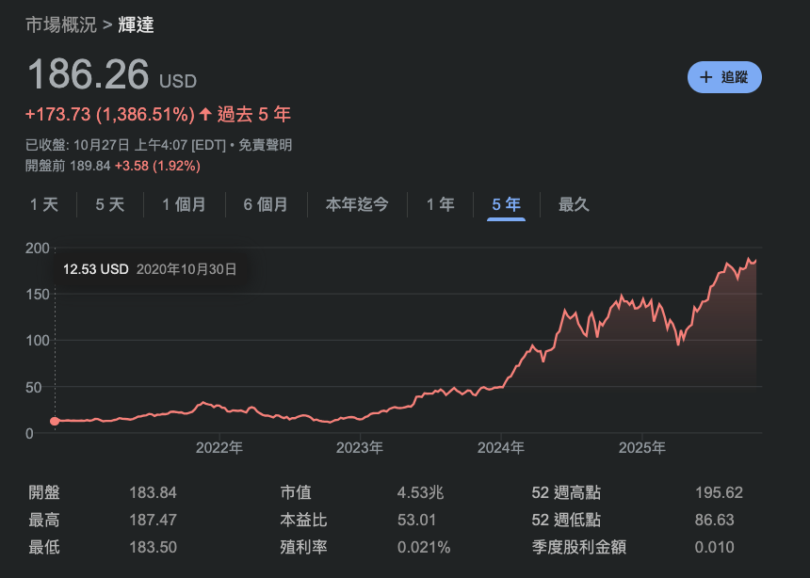

Slide 20
電腦是如何學習自然語言呢？

Slide 21


影像 vs. 文字
28 x 28 的矩陣
I want to study AI
?
Figure source: https://kopu.chat/wp-content/uploads/2017/04/binary-507x380.jpeg

Slide 22
Outline
深度學習與自然語言處理的概念
Embeddings
Sentence embeddings (Document Representations)
Word embeddings

Slide 23


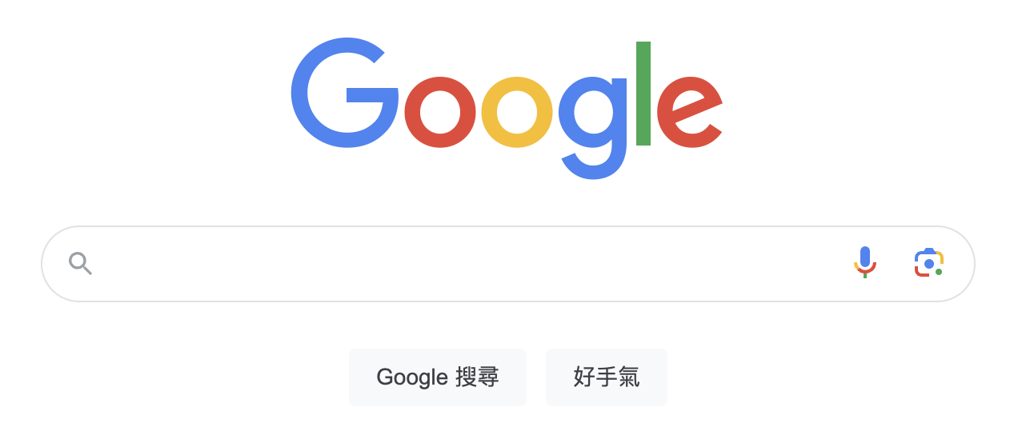
Google Search (Retrieval)
Retrieval: get relevant information from a pool (like a search engine)
誰是 Alex Honnold？

Slide 24
Google Search vs. 向量化
相似度
[0.15, 0.82, -0.34, ...]
99%
[0.93, -0.32, 0.43, ...]
98%
誰是 Alex Honnold？
[0.54, 0.95, -0.61, ...]
[0.08, 0.02, 0.83, ...]
97%
NLP 的 Embeddings: 語意資訊被嵌入到（高維度）向量空間

Slide 25
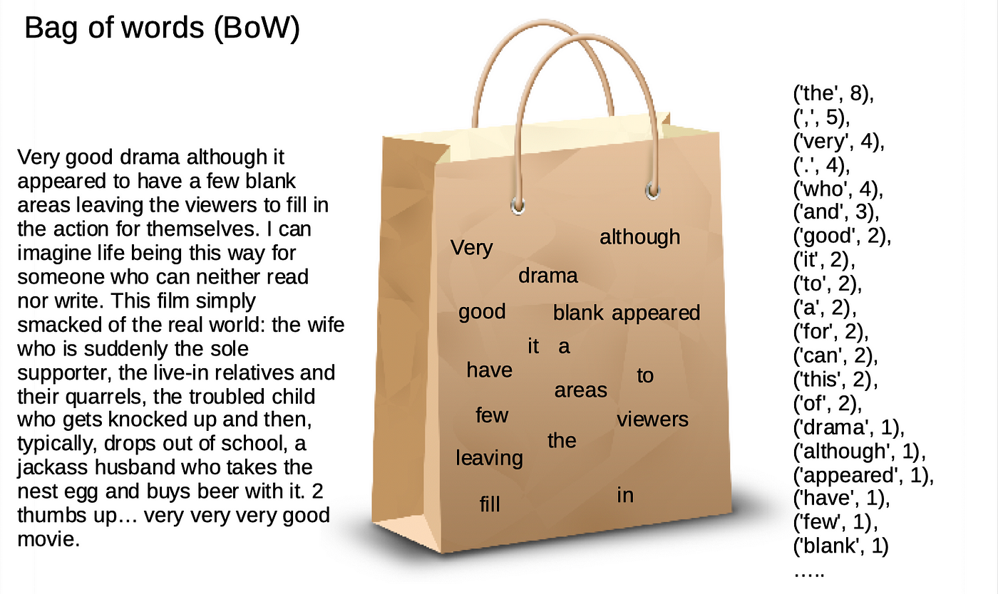
Bag-of-words Model
Meaning: Each document (sentence) carries a bag of words.
Figure source: https://sfhsu29.medium.com/nlp-入門-1-text-classification-sentiment-analysis-極簡易情感分類器-bag-of-words-naive-bayes-e40d61de9a7f

Slide 26
Bag-of-words Model (Example 1)
https://github.com/mcps5601/CGUNLP_2025_Spring/code/bow.py
Step 1: Find unique words (vocab)
Corpus
apple
eat
I
like
to
TV
watch
you
D1
I like to eat apple
Step 2: Form document vectors
D2
You like to watch TV
D1
[1, 1, 1, 1, 1, 0, 0, 0]
D2
[0, 0, 0, 1, 1, 1, 1, 1]
Notes:
The vector size is equal to the vocab size.
Each position of a vector is corresponding to the position in the vocab.

Slide 27
Bag-of-words Model (Example 2)
Step 1: Find unique words (vocab)
Corpus
apple
eat
I
like
to
TV
watch
you
D1
I like like to eat apple
Step 2: Form document vectors
D2
You I like to watch TV
D1
[1, 1, 1, 2, 1, 0, 0, 0]
D2
[0, 0, 1, 1, 1, 1, 1, 1]
Notes:
The vector size is equal to the vocab size.
Each position of a vector is corresponding to the position in the vocab.

Slide 28
TF-IDF
TF (Term Frequency; 詞頻)
IDF (Inverse Document Frequency; 逆文本頻率)
TF x IDF
＝關鍵字分數
某詞出現在該句子的頻率
某詞出現在全部文本的頻率的倒數

Slide 29
TF-IDF 為什麼這樣設計？
想像你撿到了班上三位同學的日記：
日記 A (小明的)： 「我 今天 去 吃 漢堡，漢堡 超 好吃。」
日記 B (小華的)： 「我 今天 去 學校 上課，好 累。」
日記 C (小美的)： 「我 今天 跟 媽媽 去 買 菜。」
日記 A 裡的內容觀察：
單字 | TF (在這篇很多?) | IDF (在別篇很少?) | 結果 (TF-IDF) | 意義
我 | 是 (1次) | 否 (每句都有) | 低分 | 雜訊/不重要
今天 | 是 (1次) | 否 (每句都有) | 低分 | 雜訊/不重要
漢堡 | 是 (2次) | 是 (別句都沒提) | 高分 | 關鍵字！

Slide 30
Sentence Embeddings: TF-IDF
日記 A (小明的)：「我 今天 去 吃 漢堡，漢堡 超 好吃。」
日記 B (小華的)：「我 今天 去 學校 上課，好累。」
日記 C (小美的)：「我 今天 跟 媽媽 去 買 菜。」
字典大小
 | 我 | 今天 | 去 | 吃 | 漢堡 | 超 | 好吃 | 學校 | 好累 | 跟 | ...
TF | 1/8 =0.125 | 1/8 =0.125 | 1/8 =0.125 | 1/8 =0.125 | 2/8 =0.25 | 1/8 =0.125 | 1/8 =0.125 | 0 | 0 | 0
IDF | log(3/3)=0 | log(3/3)=0 | log(3/3)=0 | log(3/1)=0.48 | log(3/1)=0.48 | log(3/1)=0.48 | log(3/1)=0.48 | log(3/1)=0.48 | log(3/1)=0.48 | log(3/1)=0.48
分數(TFxIDF) | 0 | 0 | 0 | 0.06 | 0.12 | 0.06 | 0.06 | 0 | 0 | 0

Slide 31
TF-IDF 的問題
在 TF-IDF 的世界裡，字跟字是完全獨立的。
句子 A： 「我很快樂」
句子 B： 「我很開心」
本質上仍是詞袋模型 (Bag-of-words) ，不分「順序」
句子 A： 「小明喜歡小華」
句子 B： 「小華喜歡小明」

Slide 32


Retrieval
Input Query
Which year was Oppenheimer born?
TF-IDF
Retriever
Robert Oppenheimer (born April 22, 1904, New York, New York, U.S.—died February 18, 1967, Princeton, New Jersey) was an American theoretical physicist and science administrator ...
Retrieved Documents
Knowledge Base (e.g., Wikipedia)

Slide 33
Retrieval-Augmented Generation (RAG)
Input Query
Generator
(e.g., LLM)
LLM Output
Which year was Oppenheimer born?
1967 (Without RAG)
1904 (With RAG)
TF-IDF
Retriever
Robert Oppenheimer (born April 22, 1904, New York, New York, U.S.—died February 18, 1967, Princeton, New Jersey) was an American theoretical physicist and science administrator ...
Retrieved Documents
Knowledge Base (e.g., Wikipedia)
Gao, Yunfan, et al. "Retrieval-augmented generation for large language models: A survey." arXiv preprint arXiv:2312.10997 (2023).

Slide 34
Outline
深度學習與自然語言處理的概念
Embeddings
Sentence embeddings (Document Representations)
Word embeddings

Slide 35
詞嵌入：把詞嵌入到向量 (Word2Vec)
Input
Prediction
[1] Mikolov et al. "Distributed representations of words and phrases and their compositionality." NeurIPS 2013.
Steve
Jobs
Word2Vec
(CBOW)
[MASK]
founded
Apple
非常大量的語料庫 (例如：Wikipedia)
Inc.
[MASK]
Steve
[MASK]
Jobs
Word2Vec
(Skip-gram)
founded
[MASK]
Apple
[MASK]
Inc.

Slide 36
每個字，都是一段向量 – 詞向量
Word2Vec 的範例長相:
Dimension size (e.g., 300)
apple -0.110960 0.016115 -0.004809 0.033589 0.121455 …
banana -0.027713 -0.015676 0.003314 0.077602 0.159718 …
…
…
…
Vocabulary size
(e.g., 30,000)

Slide 37
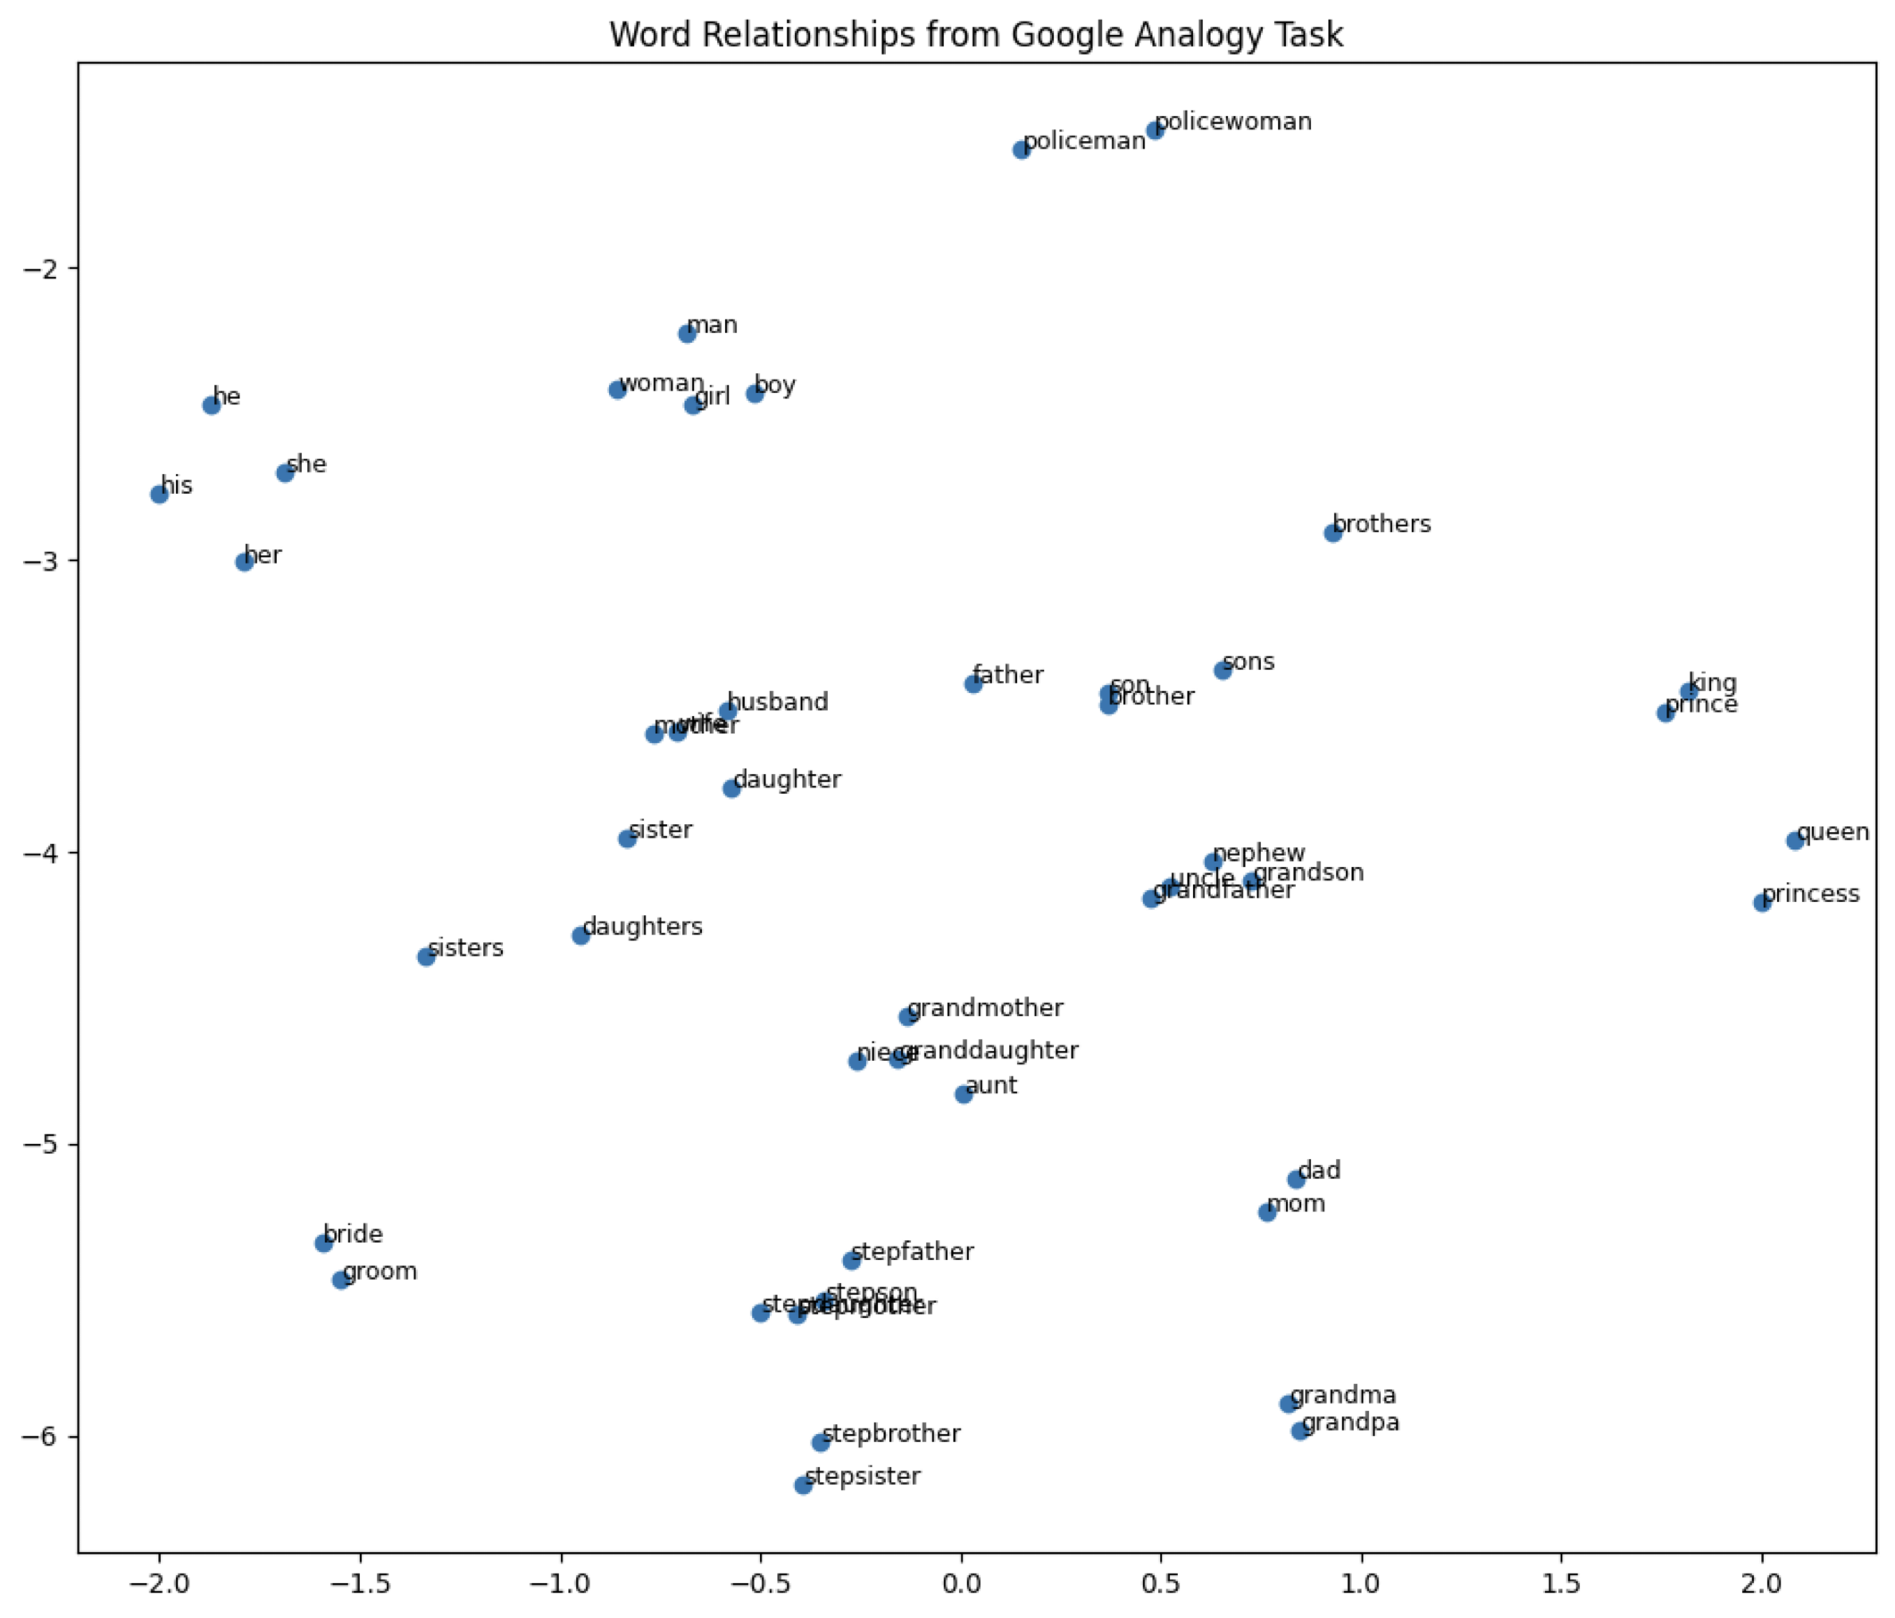
詞向量視覺化
Word embedding model: glove-wiki-gigaword-100
Dimension reduction: t-SNE
Dataset: Mikolov et al., 2013
Try it: https://www.cs.cmu.edu/~dst/WordEmbeddingDemo/

Slide 38
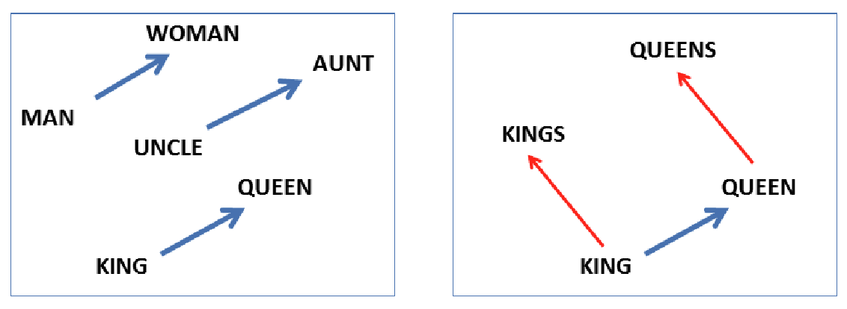
Word pairs illustrating the gender relation
b - a = d - c
d = b - a + c
b
d
d
d - b
a
d - c
c
b
b - a
c
c - a
a
b – a = d – c
(移項) d – b = c - a
Mikolov et al. “Linguistic regularities in continuous space word representations.” NAACL 2013.

Slide 39
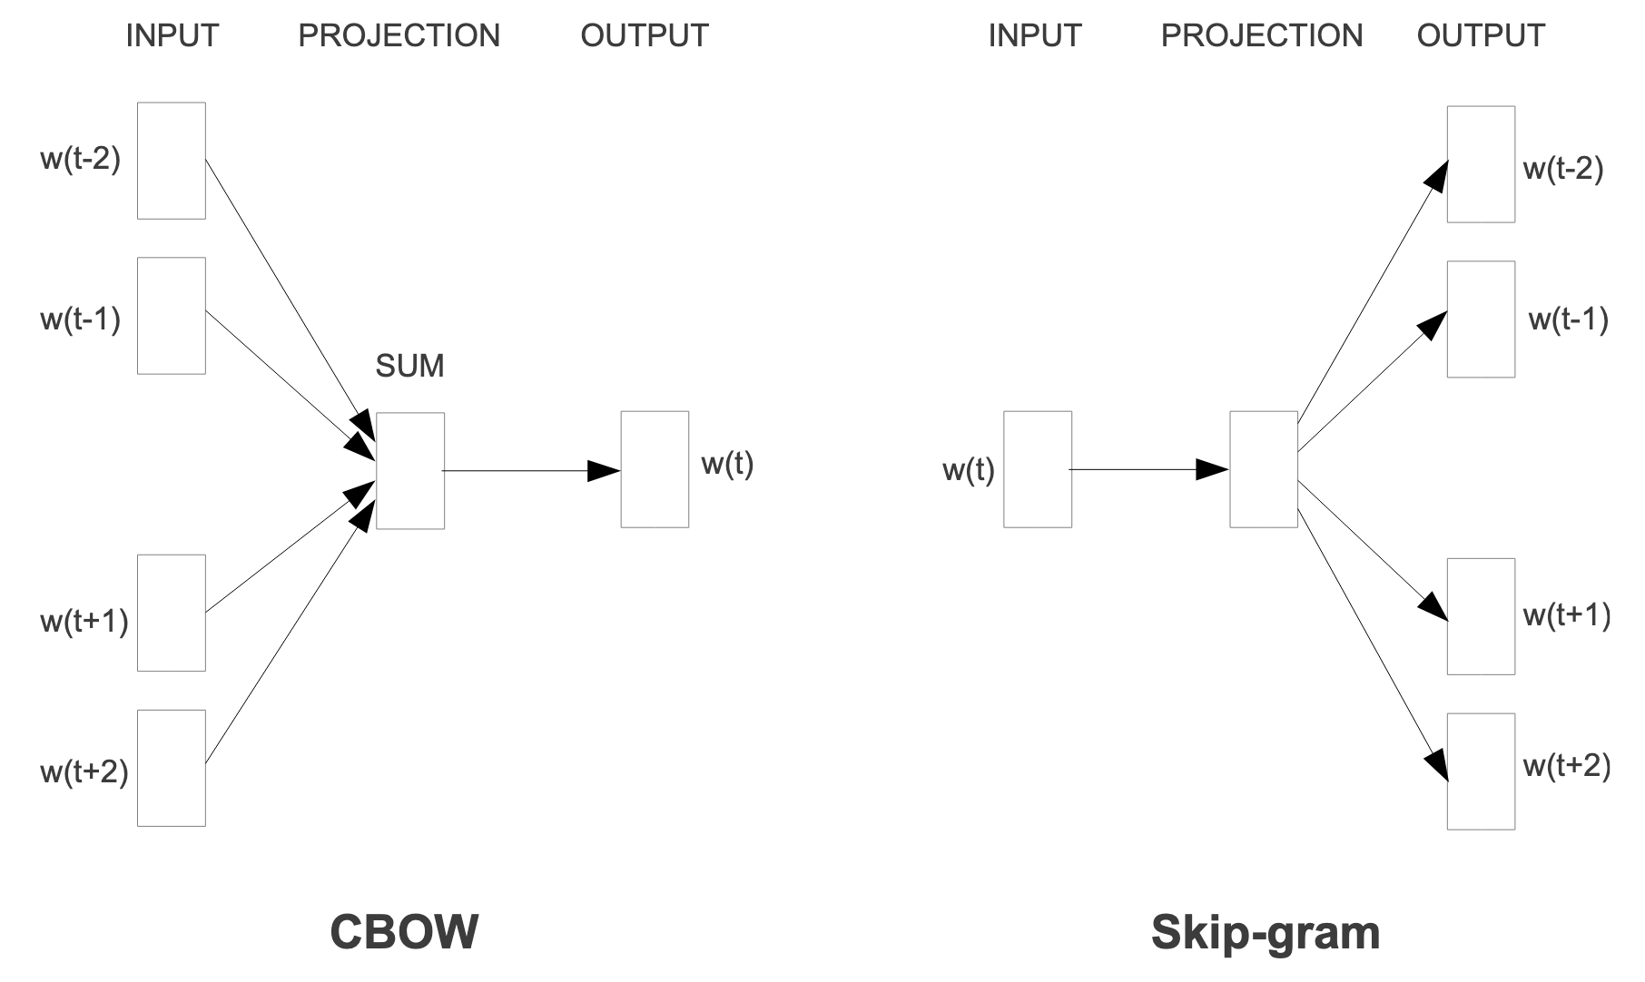
Word2Vec 是淺層神經網路
W₁: NxD
W₂: DxV
(
W₁: 1xD
W₂: DxV
)
x 4 times
Symbol | Meaning | Example
N | 輸入數量 | 4
D | Hidden size | 100
V | 字典大小 | 100,000
...
V
V
...
Word embeddings after training
...
Mikolov et al. "Efficient estimation of word representations in vector space." arXiv preprint arXiv:1301.3781 (2013).

Slide 40
Thank you!
長庚大學人工智慧學系 林英嘉
✉️ yjlin@cgu.edu.tw

